Slide 1
Save the date for the World Muscle Society Pre-Congress Teaching Course in Charleston, South Carolina, USA.

Slide 2
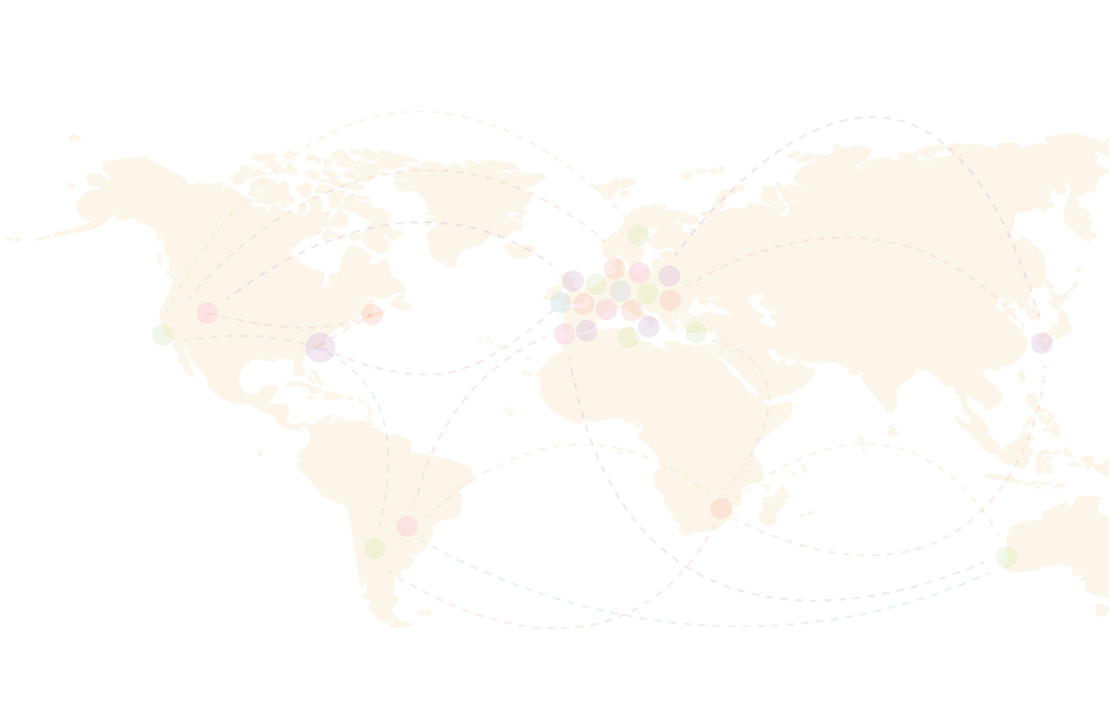
See you in
Charleston

Slide 3
Presentation Title
Full name, affiliation
The Pre-Congress
Teaching Course
Notes:
Presentation title slide

Slide 4
The Pre-Congress Teaching Course
Notes:
Presentation content slide template – OPTION 2
you can choose to use this format template for the rest of your presentation but this is not mandatory

